Slide 1



CV & Deep learning on RedHat OpenShift
Yoga Pose Estimation
Grant Steinfeld
IBM Model Asset Exchange
Technical Introduction
Using IBM CODAIT
Modeling Human Poses
Tensor Flow
How does OpenShift help?
March 4 2020

Slide 2
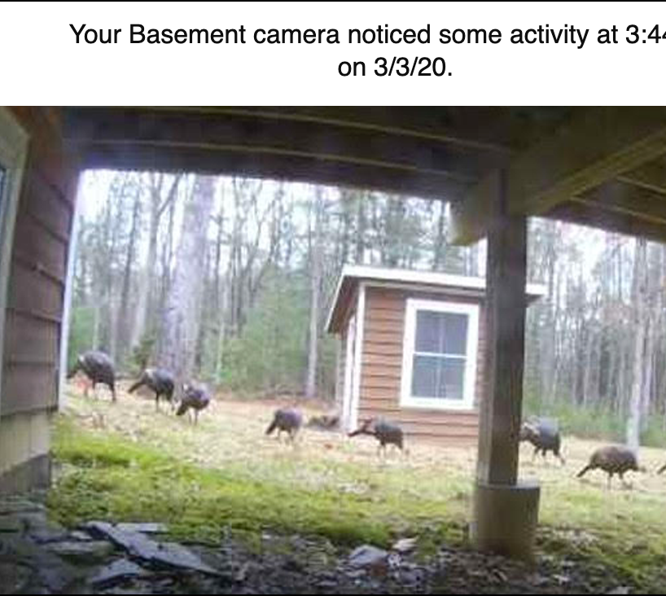
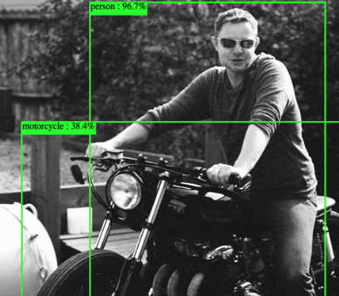
Computer
Vision(CV)
Notes:
Being able to go from idea to result with the least possible delay is key to doing good research.
Image recognition refers to technologies that identify places, logos, people, objects, buildings, and several other variables in images. Users are sharing vast amounts of data through apps, social networks, and websites. Additionally, mobile phones equipped with cameras are leading to the creation of limitless digital images and videos. The large volume of digital data is being used by companies to deliver better and smarter services to the people accessing it
Image recognition is a part of computer vision and a process to identify and detect an object or attribute in a digital video or image. Computer vision is a broader term which includes methods of gathering, processing and analyzing data from the real world. The data is high-dimensional and produces numerical or symbolic information in the form of decisions. Apart from image recognition, computer vision also includes event detection, object recognition, learning, image reconstruction and video tracking.

Slide 3
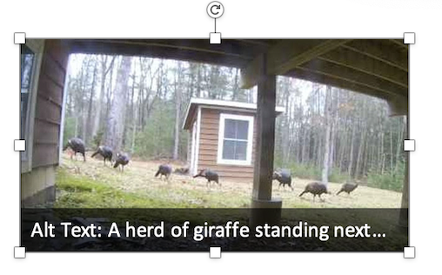
Not always perfect!

Slide 4
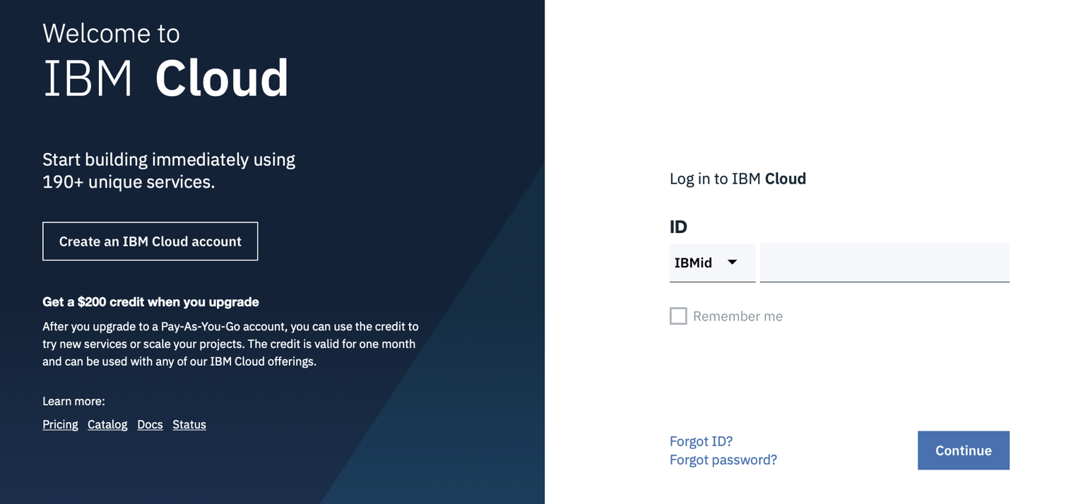
Login/Sign up => IBM Cloud Account
https://ibm.biz/BdqDVL

Slide 5
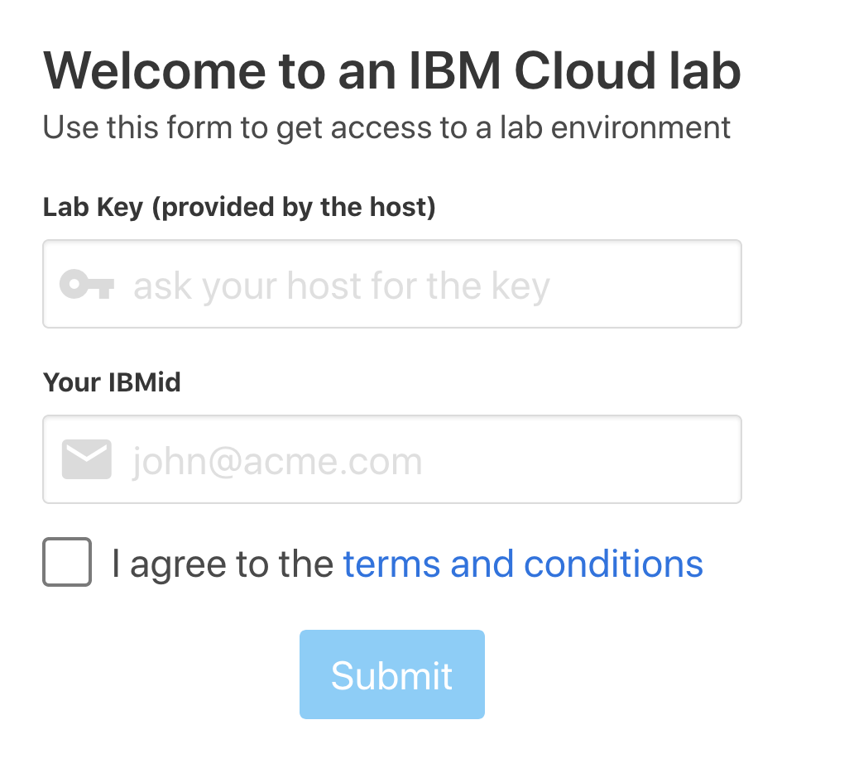
Link your Cluster - https://os4yogait.mybluemix.net/
Notes:
URL: https://os4yogait.mybluemix.net Key: oslab Region: us-east Clusters: ~20 Workers: 3 x b3c.4x16 K8s Version: 3.11.161_openshift
Note
Please be sure to click: Prefill Cache button on the URL before your lab
Don't forget you have your https://os4yogait.mybluemix.net/admin to see the status of the clusters too
If you need a cloudshell you can use https://shell.cloud.ibm.com/. It should be attached to the IBMid, that the student will have created for your workshop. If you have issues with it though please ask questions in #cloudshell-users, we do not control it.

Slide 6
Link your Cluster - https://k8syogait.mybluemix.net
Notes:
Key: ikslab Region: us-east Clusters: ~20 Workers: 3 x b3c.4x16 K8s Version: 1.15.10
Note
Please be sure to click: Prefill Cache button on the URL before your lab
Don't forget you have your https://k8syogait.mybluemix.net/admin to see the status of the clusters too
If you need a cloudshell you can use https://shell.cloud.ibm.com/. It should be attached to the IBMid, that the student will have created for your workshop. If you have issues with it though please ask questions in #cloudshell-users, we do not control it.

Slide 7
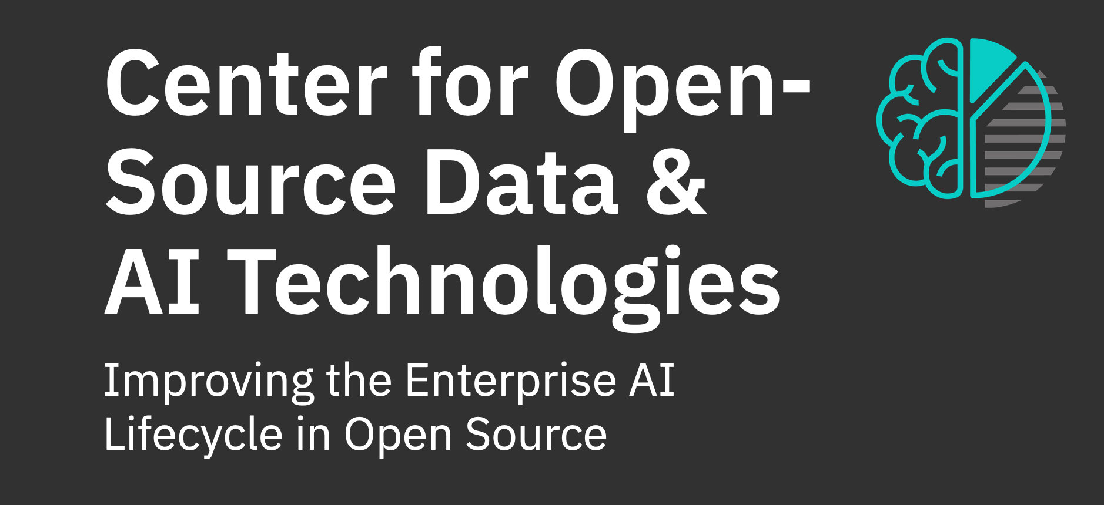
The Model Asset eXchange (MAX) on IBM Developer is a place for developers to find and use free, open source, state-of-the-art deep learning models for common application domains, such as text, image, audio, and video processing.
Notes:
The curated list includes a broad selection of deployable
(ready-to-use) models and trainable (customize-before-use) models.

Slide 8
Lab 1 – Image Classifier to OpenShift3
https://developer.ibm.com/series/create-model-asset-exchange/

Slide 9
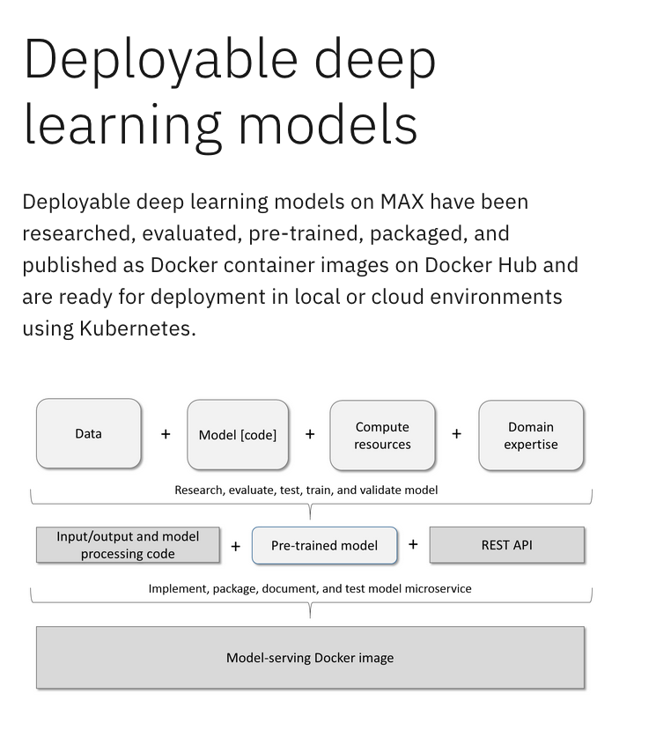

Slide 10
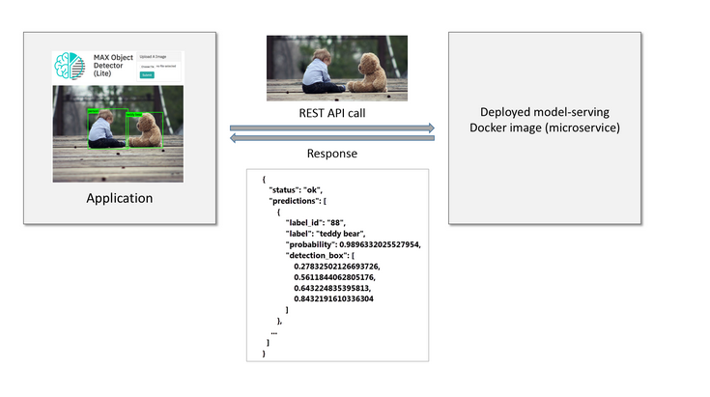
Black box
Notes:
The caller does not need to know anything about the deep learning model that powers the service, the framework that was used to implement and run the model, or the native model inputs or outputs because these details are hidden by the microservice.

Slide 11
Exploring deployable models
IoT
Serverless
Object Detection
Audio
Video
Posture
Yoga Poses
Exercise mentoring ( Mirror )

Slide 12
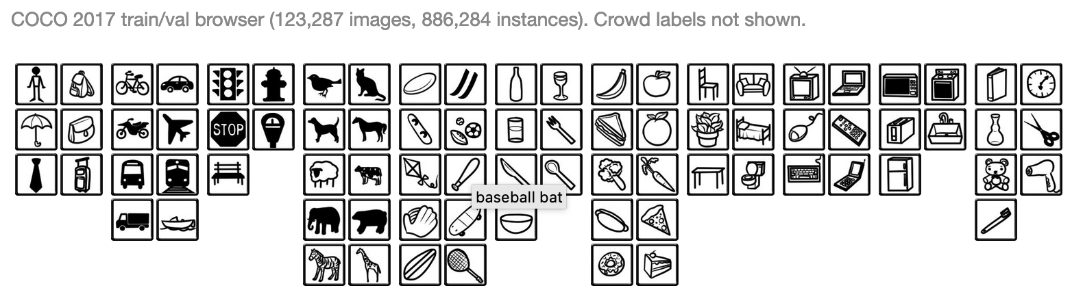
Image Recognition
COCO – Common Objects in Contect
http://cocodataset.org/#explore
Deformable Convolutional Networks - Jifeng Dai et al
http://presentations.cocodataset.org/COCO17-Detect-MSRA.pdf
Pattern Analysis Statistical Modelling and Computational Learning (PASCAL2)
http://host.robots.ox.ac.uk/pascal/VOC/voc2012/

Slide 13
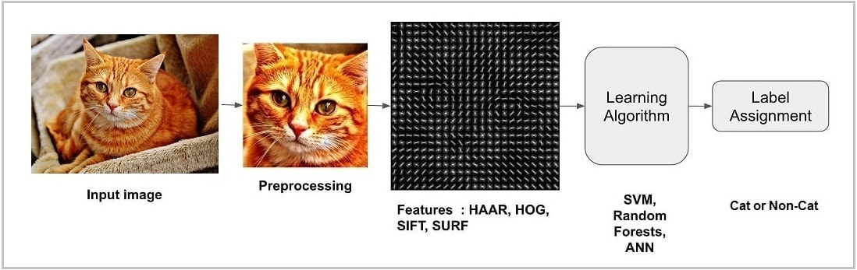
Notes:
Organizing data involves classification and feature extraction. The first step in image classification is to simplify the image by extracting important information and leaving out the rest. For example, in the below image if you want to extract cat from the background you will notice a significant variation in RGB pixel values.
However, by running an edge detector on the image we can simplify it. You can still easily discern the circular shape of the face and eyes in these edge images and so we can conclude that edge detection retains the essential information while throwing away non-essential information. Some well-known feature descriptor techniques are Haar-like features introduced by Viola and Jones, Histogram of Oriented Gradients (HOG), Scale-Invariant Feature Transform (SIFT), Speeded Up Robust Feature (SURF) etc.

Slide 14
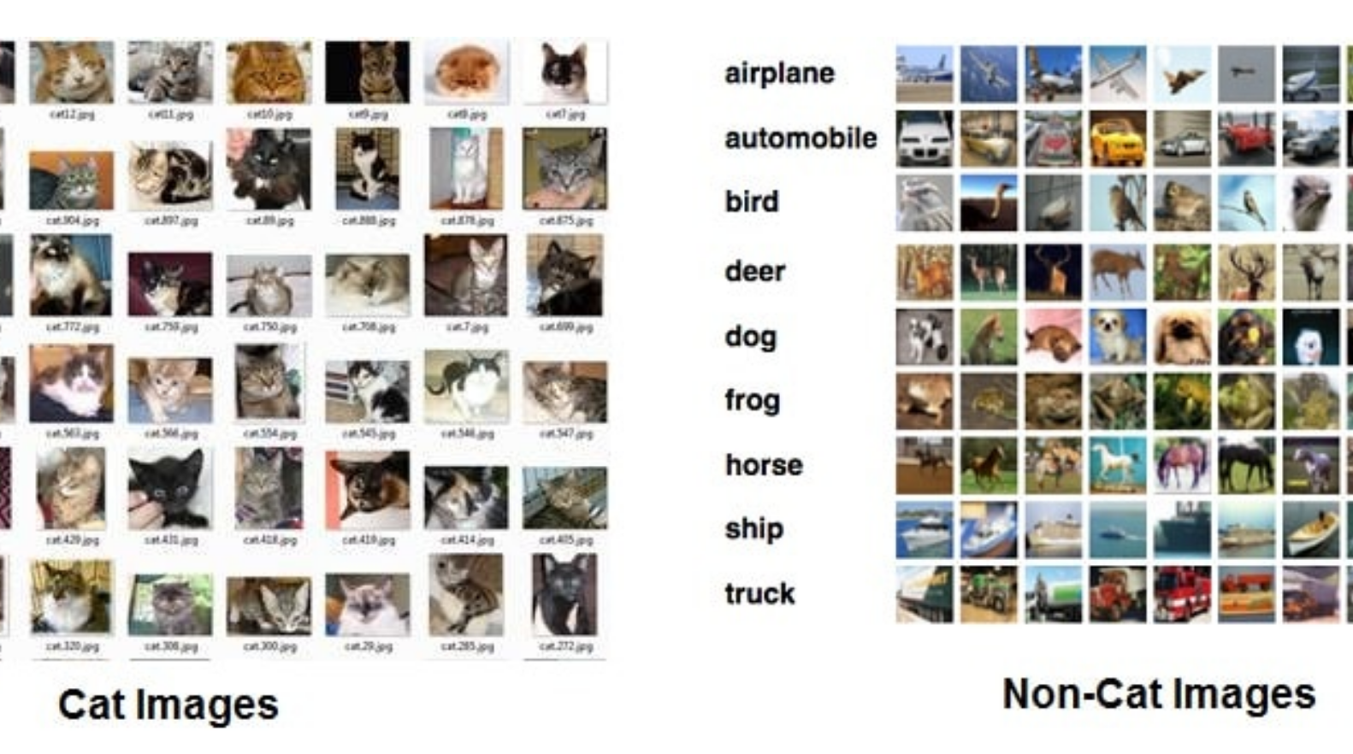
predictive mode
`A neural network is a function that learns the expected output for a given input from training datasets`
https://marutitech.com/working-image-recognition/
Notes:
To build a predictive model we need neural networks. The neural network is a system of hardware and software similar to our brain to estimate functions that depend on the huge amount of unknown inputs.

Slide 16
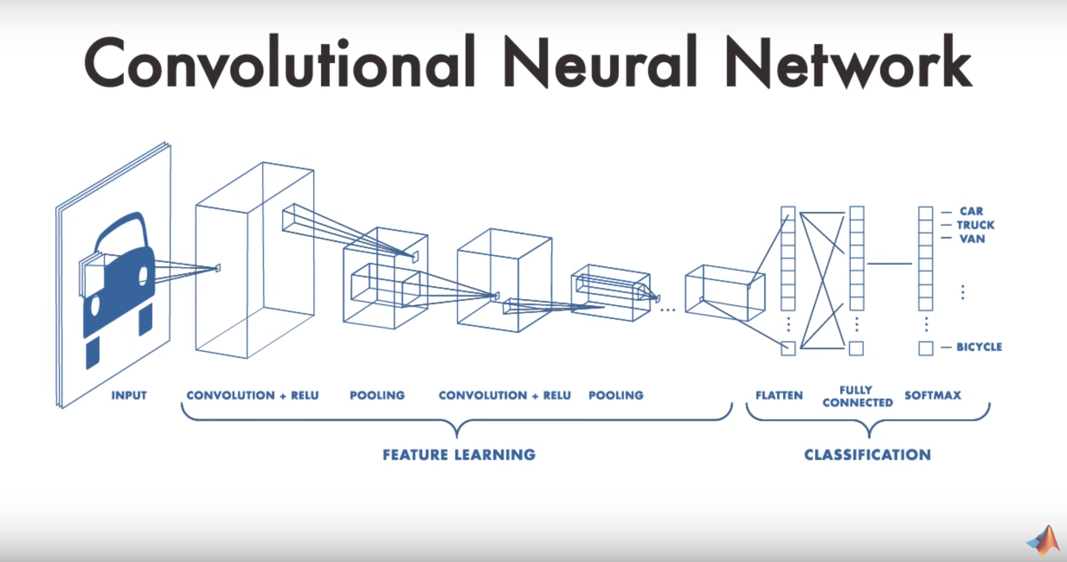
MATLAB - MATHWORKS
https://www.mathworks.com/solutions/deep-learning/features.html?s_eid=PSM_15028
https://www.youtube.com/watch?v=3cSjsTKtN9M
Notes:
Deep Learning – Deep refers to the number of hidden
layers typical 2 – 3 ( but can be +/– 150 )

Slide 17
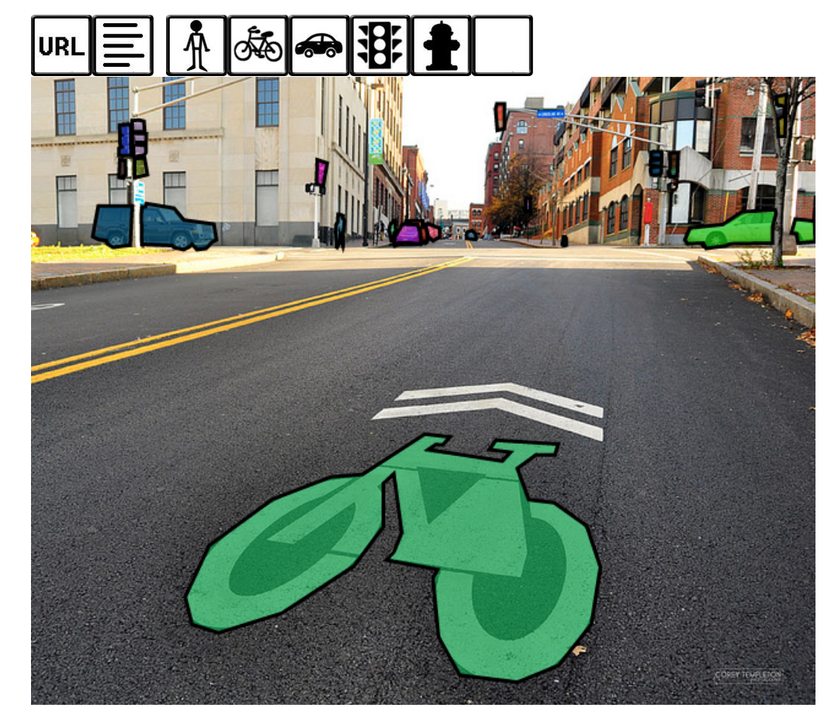
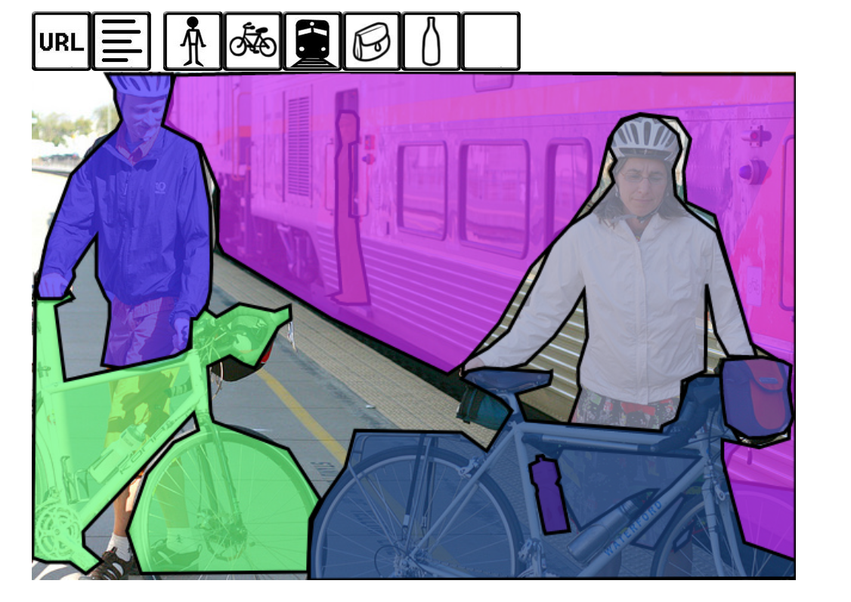
Notes:
http://cocodataset.org/#explore

Slide 18
Resources
https://www.tensorflow.org/
https://keras.io/
https://marutitech.com/working-image-recognition/
Notes:
Keras is a high-level neural networks API, written in Python and capable of running on top of TensorFlow, CNTK, or Theano. It was developed with a focus on enabling fast experimentation. Being able to go from idea to result with the least possible delay is key to doing good research.
Use Keras if you need a deep learning library that:
Allows for easy and fast prototyping (through user friendliness, modularity, and extensibility).
Supports both convolutional networks and recurrent networks, as well as combinations of the two.
Runs seamlessly on CPU and GPU.

Slide 19
Thank you
Grant Steinfeld
@gsteinfeld
www.ibm.com/blockchain
developer.ibm.com/blockchain
www.hyperledger.org
© Copyright IBM Corporation 2019. All rights reserved. The information contained in these materials is provided for informational purposes only, and is provided AS IS without warranty of any kind, express or implied. Any statement of direction represents IBM's current intent, is subject to change or withdrawal, and represents only goals and objectives. IBM, the IBM logo, and other IBM products and services are trademarks of the International Business Machines Corporation, in the United States, other countries or both. Other company, product, or service names may be trademarks or service marks of others.

